Slide 1
Data Communications for a Global Environment
Lecture 14

Slide 2
Chapter 6
Data Communications for a Global Environment
Local Area Networks

Slide 3
Why do we need a LAN?
Data Communications for a Global Environment
Information sharing
Having users access the same files, exchange information via email, or use common software applications such as Sharepoint, PEEPS
Resource sharing
Having hardware devices shared by all users
eg. Printers, Servers
Having software packages shared by all users on a LAN
eg. E-learning, Crimson Careers, etc.
Results in better decision making and reduced cost

Slide 4
Sharing COTS Software on a LAN
Data Communications for a Global Environment
Purchase software on a per seat basis
Install software on a server for all to use
No need to have a copy on every computer on the LAN
Reduces cost
Simplifies maintenance and upgrades
Example
LAN: a 30 client network
Purchase only a 10-seat license for a software program (instead of purchasing 20 copies of the same program)
Assumes that only 10 users would simultaneously use the software

Slide 5
LAN Metering
Data Communications for a Global Environment
Used to control the number of copies of a software used on a LAN
Typically comes with many software packages used on LANs
Keeps track of the users
Prohibits using more copies of the package than the licensed number
Helps to minimize Copyright violations
40% of SW used in the world is illegal, $13B Loss

Slide 6
Network Types
Data Communications for a Global Environment
Dedicated server network
A server (computer) permanently assigned a specific task
Most popular network type
90% of all LANs
Peer-to-peer network
No dedicated servers used
All computers act as both clients and servers
Cheaper than dedicated, but less capability

Slide 7
Dedicated Server Networks
Data Communications for a Global Environment
Requires one or more dedicated computers (servers)
Permanently assigned a specific task (Web server, e-mail server, file server or print server)
Enable users to share files, printers, etc.,
May form a powerful enterprise network replacing mainframes
May form a server farm (many servers part of a network)
Runs a server network operating system (NOS)
Windows NT, LINUX
Also requires a special communication software to enable communications with client computers

Slide 8
Types of Dedicated Servers
Data Communications for a Global Environment
Common Types:
Web servers, e-mail servers, database servers
Others
File servers
Allows many users to share the same files on a common disk drive
Typically with restricted access
Print servers
Handle print requests
Could be a separate computer or a “black box”
Remote Access Servers
Enable users to dial in and out of the LAN by phone (via modems)

Slide 9
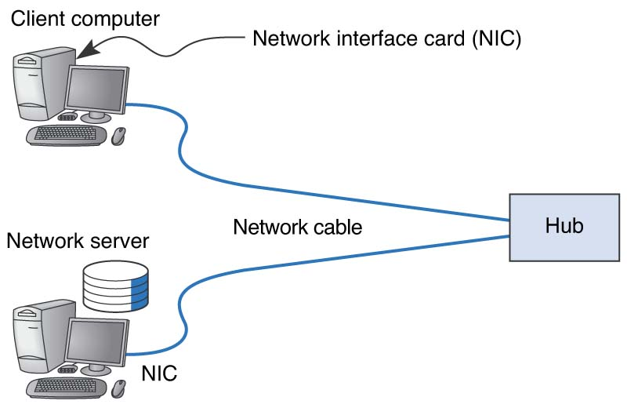
Basic LAN Components
Data Communications for a Global Environment
Client NOS
or Switch
Server NOS

Slide 10
Network Interface Cards (NICs)
Data Communications for a Global Environment
Contains physical and data link layer protocols
Includes a unique data link layer address (called a MAC address), placed in them by their manufacturer
Includes a socket allowing computers to be connected to the network
Organizes data into frames and then sends them out on the network

Slide 11
Network Cables
Data Communications for a Global Environment
Used to connect a computer physically to the network
Types of cables
Unshielded twisted wire pairs (UTP) – leading LAN cable type
Shielded twisted pair (STP)
Coaxial cable – heavy, not flexible
Optical fiber – high capacity, just beginning in LANs
May include multiple different types cables
Requires a special connector typically RJ45 (not the telephone RJ45)

Slide 12
Network Cables Categories
Data Communications for a Global Environment
Category | Speed | Use
1 | 1 Mbps | Voice Only (Telephone Wire)
2 | 4 Mbps | LocalTalk & Telephone (Rarely used)
3 | 16 Mbps | 10BaseT Ethernet
4 | 20 Mbps | Token Ring (Rarely used)
5 | 100 Mbps (2 pair) 1000 Mbps (4 pair) | 100BaseT Ethernet Gigabit Ethernet
5e | 1,000 Mbps | Gigabit Ethernet
6 | 10,000 Mbps | Gigabit Ethernet

Slide 13
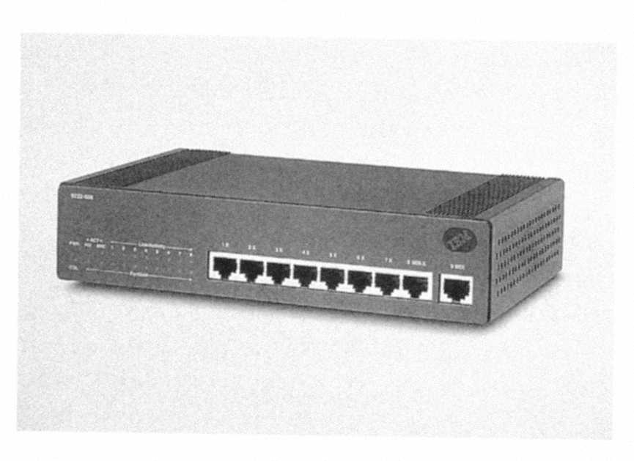
Hubs & Switches
Data Communications for a Global Environment
Act as junction boxes, linking cables from several computers on a network
Usually sold with 4, 8, 16 or 24 ports
May allow connection of more than one kind of cabling, such as UTP and coax.
Repeat (reconstruct and strengthen) incoming signals
Important since all signals become weaker with distance
Extends the maximum LAN segment distance

Slide 14
Network Operating Systems
Data Communications for a Global Environment
Software that controls the LAN
Parts of NOS
Server version of NOS
Runs on the network servers
Client version of NOS
Runs on the client computers
Directory Service
Provide information about resources on the LAN
Network Profiles
Indicate the resources available in the network and authorized users

Slide 15
NOS Server Software
Data Communications for a Global Environment
Enables servers to operate
Handles all network functions
Performs data link, network, and application layer functions
Acts as the application software by executing and responding to the requests sent to them by clients
Replaces the normal OS on the server
Optimized to provide better performance and faster response time (for its limited number of operations)
Examples
MS Windows NT
LINUX

Slide 16
NOS Client Software
Data Communications for a Global Environment
Provides data link and network layer functions
Interacts with application software and computer’s own operating system
Included in most OS packages such as Windows VISTA and Windows 7
Allows client to view and access available network resources

Slide 17
NOS Directory Service
Data Communications for a Global Environment
Provides information about resources on the LAN
Example is Active Directory Service (ADS) by Microsoft
An AD structure is a hierarchical arrangement of information about objects.
The objects fall into two broad categories:
- Resources (e.g. printers)
- Security Principles (User or computer accounts and groups)
Each object represents a single entity (user, computer, printer, or a group) and is uniquely identified by its name and its attributes (the characteristics and information that the object represents) defined by a schema

Slide 18
NOS Directory Service
Data Communications for a Global Environment
An AD framework that holds the objects can be viewed at a number of levels:
- Forrest
- Tree
- Domain
Domains are identified by their DNS name structure, the namespace
A Tree is a collection of one or more Domains in a contiguous namespace
A Forrest is a collection of trees that share a common global catalog, directory schema, logical structure and directory configuratiion

Slide 19
NOS Directory Service
Data Communications for a Global Environment
Objects held within a domain can be grouped into Organizational Units (OU’s). The OU is the recommended level at which to apply group policies.
Duplicate names cannot exist within a domain.
e.g. you cannot have Fred.student.ou and Fred.staff.ou
The AD database, in Windows 2000 server uses the JET Blue-based Extensible Storage Engine and is limited to 16 terabytes and 2 billion objects (but only 1 billion security principles)
To allow users in one domain to access resources in another domain AD uses trusts.
Trusts inside a Forrest are automatically set when the domain is created
The Forrest sets the default boundary for a trust.
Implicit Transitive Trusts are automatic for all domains within a

Slide 20
NOS Directory Service
Data Communications for a Global Environment
Forrest – WidgetsCorp
Tree – Eastern
Domain – Boston
Domain – New York
Domain – Philly
Tree – Southern
Domain – Atlanta
Domain - Dallas
Domain – Dallas
OU – Marketing
Bob
Sally
Dave
OU – Sales
Steve
Jane

Slide 21
Topology
Data Communications for a Global Environment
Basic geometric layout of the network
The way computers on the network interconnected
Logical Topology
How the network works conceptually
Like a logical data flow diagram (DFD) or
Like a logical entity relation diagram (ERD)
Physical Topology
How the network is physically installed
Like physical DFD or physical ERD

Slide 22
Shared Ethernet’s Logical Topology
Data Communications for a Global Environment
Viewed logically as a bus topology
All messages from any computer flow onto the central cable (bus)
A computer receive messages from all other computers, whether the message is intended for it or not
When a frame is received by a computer, the first task is to read the frame’s destination address to see if the message is meant for it or not

Slide 23
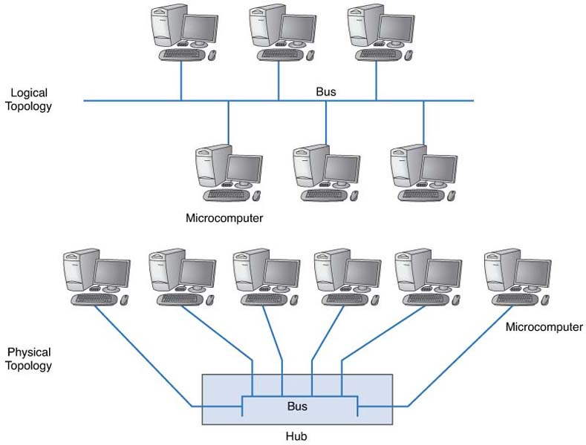
Shared Ethernet’s Physical Topology
Data Communications for a Global Environment

Slide 24
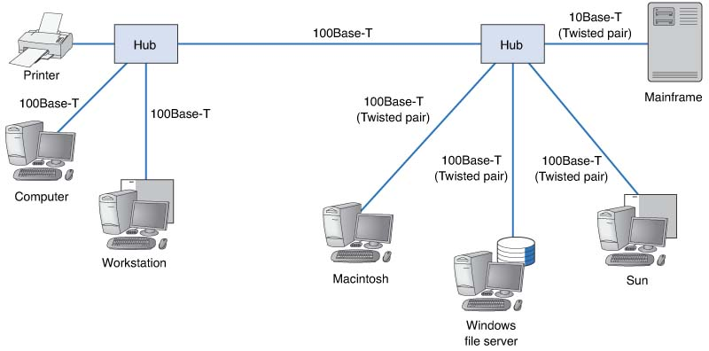
Multiple Hub Ethernet Design
Data Communications for a Global Environment

Slide 25
Media Access Control (MAC)
Data Communications for a Global Environment
Uses a contention-based protocol called CSMA/CD (Carrier Sense Multiple Access / Collision Detect)
Frames can be sent by two computers on the same network at the same time
They will collide and become garbled
Can be termed as “ordered chaos”
Tolerates, rather than avoids, collisions

Slide 26
CSMA/CD
Data Communications for a Global Environment
Carrier Sense (CS):
Listen to the bus to see if another computer is transmitting before sending anything
Transmit when no one is transmitting
Multiple Access (MA):
All computers have access to the network medium
Collision Detect (CD):
Declared when any signal other than its own detected
If a collision is detected
To avoid a collision, wait a random amount of time and then resend message

Slide 27
Ethernet Physical Media Format
Data Communications for a Global Environment
Data Rate for Medium (e.g., 10 = 10Mbps)
Broadband (analog) cable transmissions (more than one channel (e.g., cable TV))
[Value1]Base/Broad[-Value2]
Baseband Mode (only one (digital) channel)
maximum distance possible (in 100 of meters) or
cable type:
T= twisted pair,
F =fiber)

Slide 28
Twisted Pair Ethernets
Data Communications for a Global Environment
10Base-T
Uses Cat 3 and Cat 5 UTP, very inexpensive
Runs up to 100 meters
Rapidly losing ground to 100Base-T
100Base-T
Uses Cat 5 UTP
Also called Fast Ethernet, replaced 10Base-T in sales volume
More common format in Ethernet today
Combined 10/100 Ethernet
Some segments run 10Base-T and some run 100Base-T

Slide 29
Fiber Optic based Ethernets
Data Communications for a Global Environment
1000Base-T (1 GbE)
Gigabit Ethernet.
Maximum cable length is only 100 m for UTP cat5
Fiber Optic based (1000Base-LX) runs up to 440 meters
1000Base-F
1 Gbps fiber
10 GbE
10 Gbps Ethernet. Uses fiber and is typically full duplex
40 GbE
40 Gbps Ethernet. Uses fiber and is typically full duplex.

Slide 30
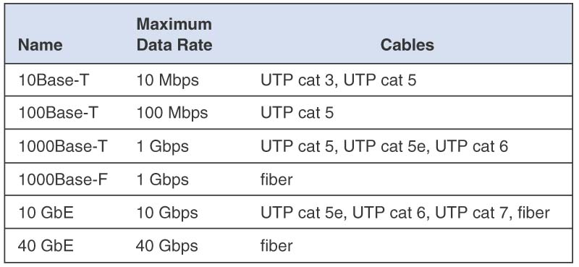
Summary - Ethernet Media Types
1.
Data Communications for a Global Environment

Slide 31
Ethernet (IEEE 802.3)
Data Communications for a Global Environment
Used by almost all LANs today
Originally developed by a consortium of Digital Equipment Corp., Intel and Xerox
Standardized as IEEE 802.3
Types of Ethernet
Shared Ethernet
Uses hubs
Switched Ethernet
Uses switches

Slide 32
Switched Ethernet Topology
Data Communications for a Global Environment
Uses switches (instead of hubs)
Designed to support a small set of computers
(16 to 24) in one LAN
Looks similar to a hub, but very different inside
Designed to support a group of point-to-point circuits
No sharing of circuits
Logical and physical topology of the network becomes a star topology via switch
Switch reads destination address of the frame and only sends it to the corresponding port
While a hub broadcasts frames to all ports

Slide 33
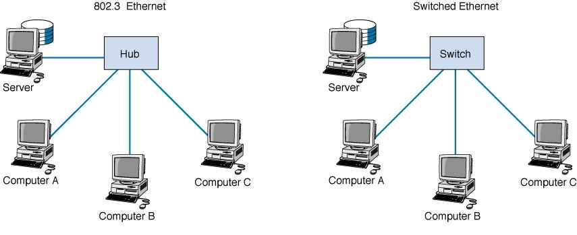
Basic Switch Operation
Data Communications for a Global Environment
Forwarding Table based on MAC/Port:
S 1
A 2
B 3
C 4
Layer 2
Port 1
2
3
4
When a frame is received, the switch reads its Layer 2 data link layer destination address and sends the frame out of the corresponding port in its forwarding table.

Slide 34
Learning Switch Operation
Data Communications for a Global Environment
Forwarding Table based on MAC/Port:
S 1
A 2
B 3
C 4
Switch starts by working like a simple hub
With an empty forwarding table
It gradually fills its forwarding table by
learning about the nodes
Reads the source MAC address of the incoming frame and records it to the corresponding port number
Reads the destination MAC address. If not in the Table then it broadcasts the frame to all ports
Waits for the destination computers to respond, and repeats the first step

Slide 35
Modes of Switch Operations
Data Communications for a Global Environment
Cut through switching
Read destination address and start transmitting
Without waiting for the entire message is received
Low latency; but may waste capacity (error messages)
Only on the same speed incoming and outgoing circuits
Store and forward switching
Wait until the whole message is received, perform error control, and then transmit it
Less wasted capacity; slower network
Circuit speeds may be different
Fragment free switching
Read the first 64 byte segment (contains the header)
Perform error check, if it is okay then start transmitting
Compromise between previous two modes

Slide 36
MAC in Switched Ethernet
Data Communications for a Global Environment
Each circuit shared by a computer and the switch
Still CSMA/CD media access control used
Each device (computer or switch) listens before transmitting
Multiple messages can be sent at the same time.
Computer A can send a message to computer B at the same time that computer C sends one to computer D
Two computers send frames to the same destination at the same time
Switch stores the second frame in memory until it finishes sending the first, then forwards the second

Slide 37
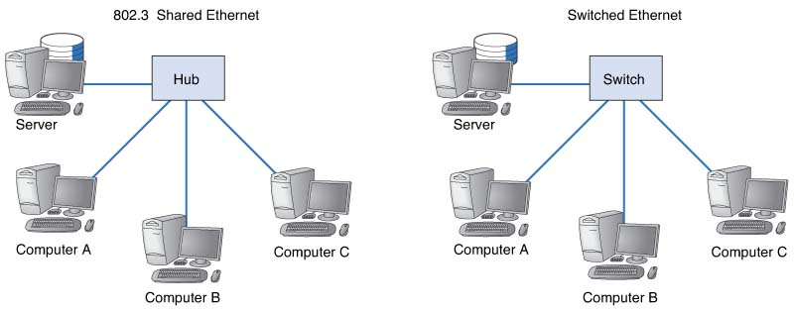
Performance Comparison
Data Communications for a Global Environment
Capable of using about only 50% of capacity (10BaseT) before collisions become a problem
Runs at up to 90% capacity on 100Base-T

Slide 38
Factors in LAN Design
Data Communications for a Global Environment
Effective Data Rates
Data Link Protocol Efficiency
MAC Protocol Efficiency
Costs
Newer technologies are expensive
Prices drop over time
10Base-T, 100Base-T and Switched Ethernet are inexpensive
1 GbE and 10GbE are still expensive

Slide 39
Effective Data Rates
Data Communications for a Global Environment
Maximum speed in bits the hardware layers can provide
Depends on
Nominal data rate (provided by Physical layer)
100Base-T → 100 Mbps
Error rate (determines retransmissions)
Efficiency of data link layer protocol
Percentage of transmission that contains user data
Depends on the number of overhead bits
Efficiency of MAC protocol
How well the MAC protocol can use the nominal data rate

Slide 40
Data Link Protocol Efficiency
Data Communications for a Global Environment
Efficiency of Data Link layer depends on a typical packet size
33-byte overhead in a 1500-byte packet
→ 97.8% efficiency (assuming no retransmission)
33-byte overhead in a 9000 byte (jumbo) packet
→ 99.6% efficiency
33-byte overhead in a 150 byte (small) packet
→ 82% efficiency
Average efficiency on a LAN
Depends on the traffic patterns
Typically, a small number of HTTP or SMTP request packets followed by about 20 larger packets will yield a 97% reasonable estimate for LAN traffic

Slide 41
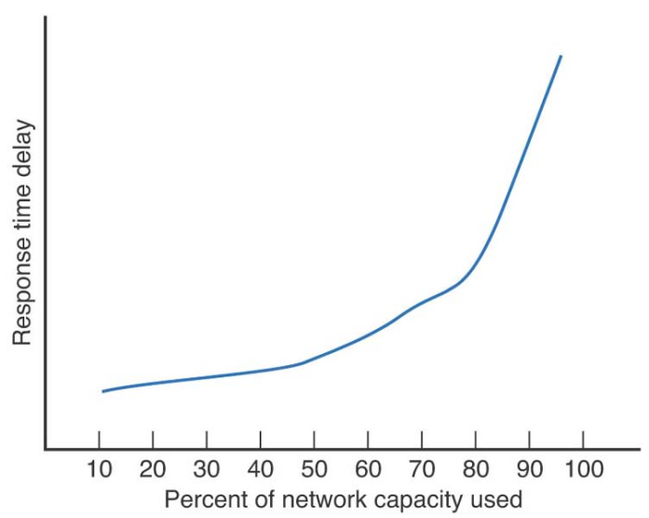
MAC Protocol Efficiency
Data Communications for a Global Environment
CSMA/CD works well in low traffic LANs
Response time vs. utilization: a good indicator
Works well when it is under 50% capacity
Examples:
10Base-T: 50% capacity x 97% efficiency x 10 Mbps rate
→ 4.85 Mbps (shared by all computers on the LAN)
100Base-T: 80% capacity x 97% efficiency x 100 Mbps
→ 78 Mbps (total effective rate, but this is shared)

Slide 42
Effective Rate for a Computer
Data Communications for a Global Environment
Depends on number of computers using the LAN simultaneously
A typical LAN has 20 users; but not all of them use the LAN at the same time
Examples of effective rate calculations:
2 simultaneous users on a 10Base-T
4.85 Mbps / 2 → 2.425 Mbps / per computer
10 simultaneous users on a 10Base-T
4.85 Mbps / 10 → 485 Kbps / per computer
10 simultaneous users on a 100Base-T
78 Mbps / 10 → 7.8 Mbps / per computer

Slide 43
Effective Rates for Switched Ethernets
Data Communications for a Global Environment
Dramatic improvements over non-switched Ethernet LANs
95% capacity efficiency
Examples:
10Base-T: 95% capacity x 97% efficiency x 10 Mbps rate
→ 9.2 Mbps
100Base-T: 95% capacity x 97% efficiency x 100 Mbps
→ 92 Mbps
1 GbE: implemented in full duplex (1 Gbps each direction)
→ 1.8 Gbps
Per computer efficiency
Same as above
Not affected by the traffic (since each has own circuit)

Slide 44
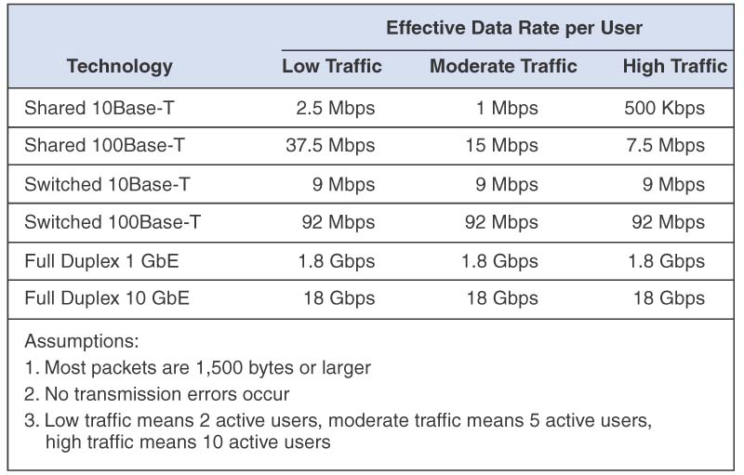
Effective Ethernet Rate Estimates
Data Communications for a Global Environment

Slide 45
Best Practice Recommendations
Data Communications for a Global Environment
Switched 10Base-T
Less susceptible to response time delays
More robust as traffic increases
Provides the best cost-performance tradeoff
Costs almost the same as Shared 10Base-T
Category 5 or 5e cables
Costs almost the same as cat3
Provides room for upgrades to 100Base-T or 100Base-T
Fiber
LAN with very high traffic needs
Used with switched 100Base-T or 1 GbE
Currently expensive

Slide 46
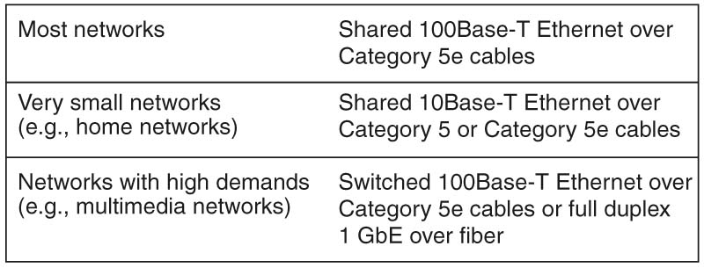
Best Practice Recommendations
Data Communications for a Global Environment

Slide 47
Improving LAN Performance
Data Communications for a Global Environment
Throughput:
Used often as a measure of LAN performance
Total amount of user data transmitted in a given period of time
To improve throughput and LAN performance, identify and eliminate bottlenecks
Bottlenecks are points in the network where congestion is occurring
Congestion is when the network or device can’t handle all of the demand it is experiencing

Slide 48
Identifying Network Bottlenecks
Data Communications for a Global Environment
Potential places are server vs. circuit
Network server
Network circuit (especially LAN-BN connection)
Client’s computer (highly unlikely, unless too old)
How to find it
Check the server utilization during poor performance
If high >60%, then the server is the bottleneck
If low <40%, then the network circuit is the bottleneck
If between 40% - 60%, both the server and circuits are the bottlenecks

Slide 49
Improving Server Performance
Data Communications for a Global Environment
Software improvements
Choose a faster NOS
Fine tune network and NOS parameters such as
Amount of memory used for disk cache
Number of simultaneously open files
Amount of buffer space
Hardware improvements
Add a second server
Upgrade the server’s CPU
Increase its memory space
Add more hard disks
Add a second NIC to the server

Slide 50
Improving Disk Drive Performance
Data Communications for a Global Environment
Especially important, since disk reads are the slowest task the server needs to do
Consider Redundant Array of Inexpensive Disks (RAID)
Replacing one large drive with many small ones
Can be used to both improve performance and increase reliability
Building redundancy into the hard drives so drive failure does not result in any loss of data

Slide 51
Improving Circuit Capacity
Data Communications for a Global Environment
Upgrade to a faster protocol
Means upgrading the NICs and possible cables
Examples:
Upgrading the network from 10Base-T to 100Base-T
Upgrading the segment to the server from 10Base-T to 100Base-T
Increase number of segments to server
Adding additional NIC cards to the servers
Increasing the number of ways to access to server
Ideal number of NICs/server = 3
More NICs may affect server’s processing capacity

Slide 52
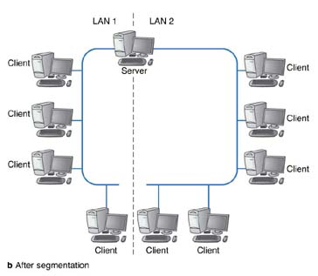
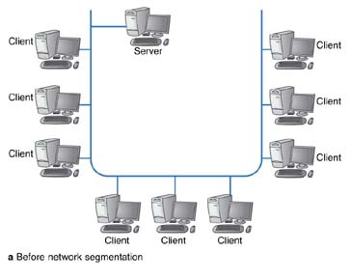
Network Segmentation
Data Communications for a Global Environment

Slide 53
Reducing Network Demand
Data Communications for a Global Environment
Move files to client computers
Such as heavily used software packages
Install disk caching software on client machines
Reduces the need to access files stored on the server
Move user demands to off peak times
Encourage users to not use the network as heavily during peak usage times such as early morning or after lunch
Delay some network intensive jobs to off-peak times, such as run heavy printing jobs at night

Slide 54
Improving LAN Performance - Summary
Data Communications for a Global Environment
Increase Server Performance
Software: Fine-tune the NOS settings
Hardware:
Add more servers and spread the network applications across the servers to balance the load
Upgrade to a faster computer
Increase the server's memory
Increase the number and speed of the server's hard disk(s)
Upgrade to a faster NIC
Increase Circuit Capacity
Upgrade to a faster circuit
Segment the network
Reduce Network Demand
Move files from the server to the client computers
Increase the use of disk caching on client computers
Change user behavior

